Slide 1

GOVERNMENT JOB APPLICATION FORM AND NOTIFICATION
PYTHON FULL STACK DEVELOPMENT
UNDER THE GUIDANCE OF
Dr. Geeta Singh
REVIEW 1

Slide 2
TEAM MEMBERS
2110030229 – Harshith
2110030259 – Rakesh
2110030260 – Anudeep
2110030249 – Tharun

Slide 3
INTRODUCTION
This PROJECT provides the ease of viewing all jobs notification from varioussources like newspapers Daily Jang, Express, Nawa-i-waqat & Dawn. Instead of searching the jobs in every newspaper, you can use this to find any job of your interest.
This project is aimed at developing an online search jobs for the Placement Details for job seekers. The system is an online application that can be accessed throughout the organization and outside as well with proper login provided.
This system can be used as an Online Job alert for job seekers. Job Seekers logging should be able to upload their information in the form of a CV.

Slide 4
PROBLEM STATEMENT
Nowadays, starting from the application process to admit card/call letter, written test, exam result as well as call letter for interview and result for final selection in almost all the government jobs is conducted online.
With increase in online trend, government job seeking candidates tend to make some mistakes that drive them into problems with submission of application process and sometimes even cancellation of it. Here we are discussing some important mistakes that candidates generally do while filling up their online application forms and also how candidates can avoid the mistakes from occurring. Below some mistakes and the easy way to avoid them are penned down.
Spelling and Grammatical Errors: One of the most common reasons for the rejection of Online applications is spelling and grammatical mistakes. With such mistakes, candidates generally attract recruiters’ attention on the proficiency over the language and the hold on it. This certainly makes the recruiter get a glimpse of the weakness with the language and its usage.

Slide 5
LITERATURE REVIEW
Government jobs are no longer cushy as they used to be once. The government is working on deliberate policies to deal with non-performers.
Applications are invited Online from qualified applicants through the Application/WEBSITE to be made available.
Applicants are advised to apply only after carefully reading and understanding the contents of this notification

Slide 6
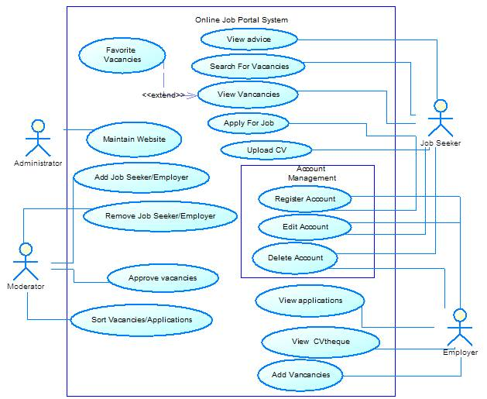
Use case diagram

Slide 7
DATASET COLLECTION AND TOOLS REQUIRED
Information was collected from several websites.
Star UML
Python FLASK
Pytesseract and open-cv packages

Slide 8
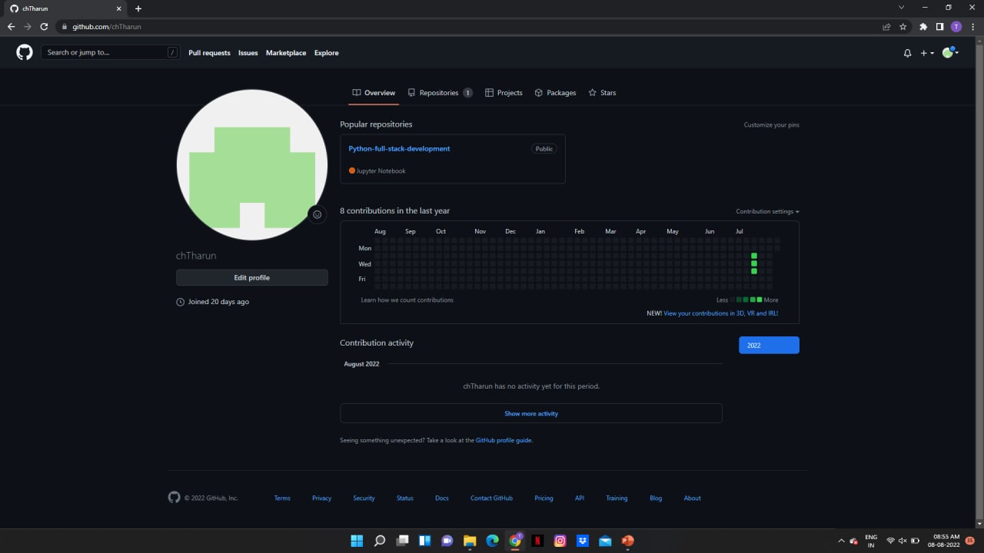
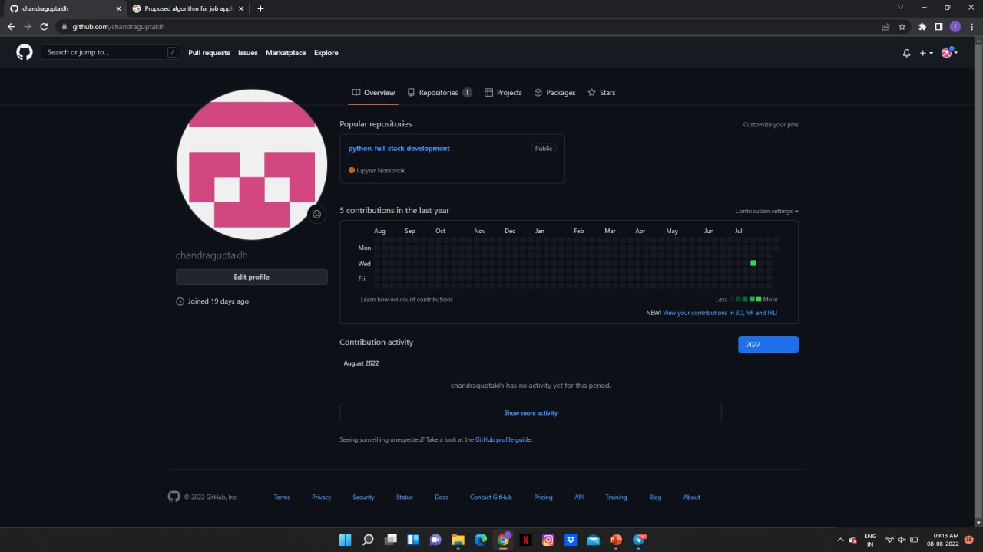
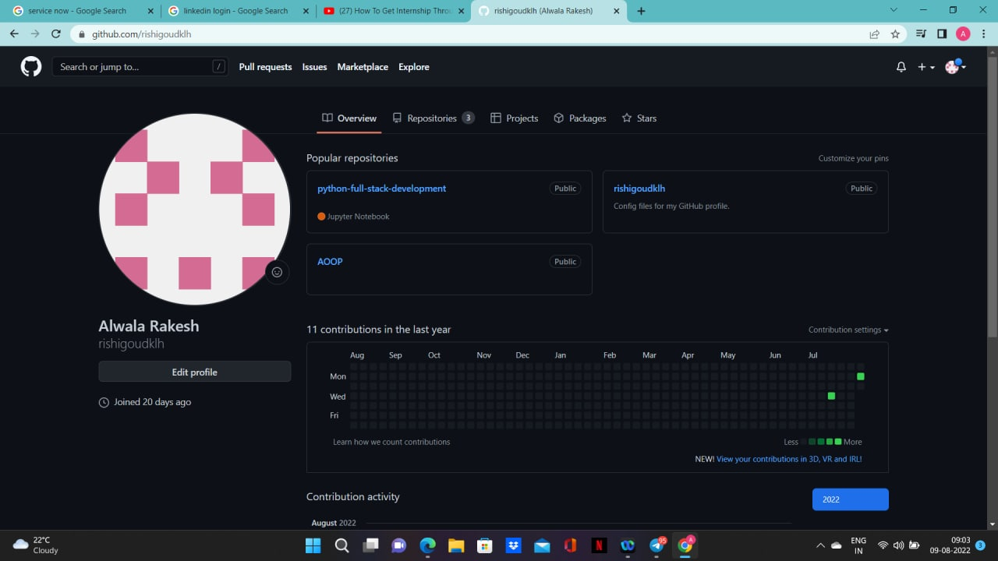
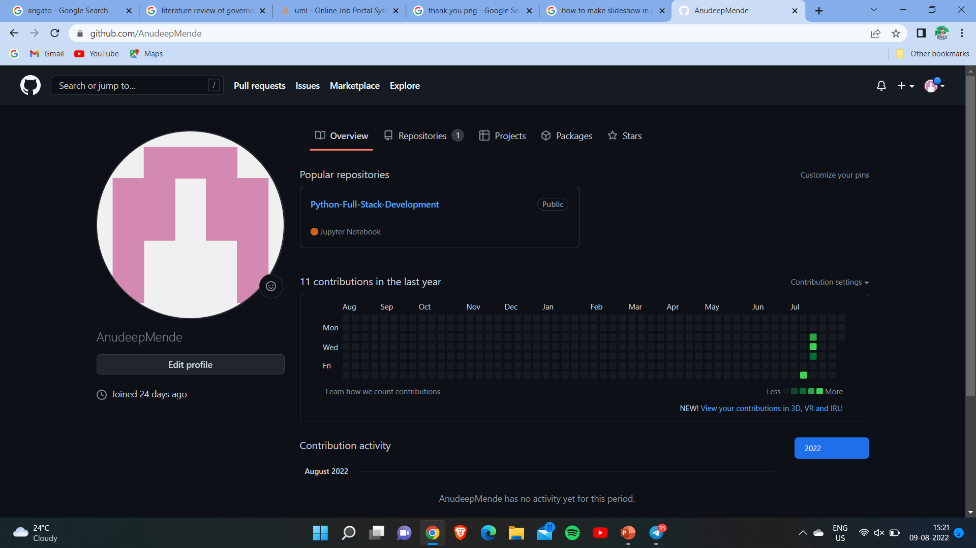
GitHub SETUP

Slide 9
DIVISION OF WORK
Class diagram- Harshith
Literature Review- Tharun
Data Set Collection- Anudeep
Problem Statement- Rakesh

Slide 10


